Slide 1

F&O Integration Roundup

Slide 2
In this session, we'll discuss each available integration technology, a high-level overview of how to use Dynamics 365 F&O along with the pros and cons for each approach, how to select a technology for an integration, and how that technology is best used
PowerPoint available for download at https://github.com/NathanClouseAX/CommunityPresentations/tree/master/2021

Slide 3
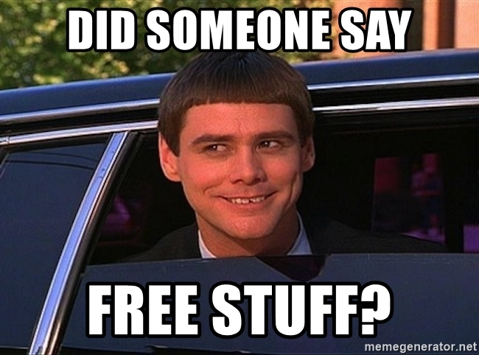
Free Stuff
Gift Card Give Away!

Slide 4

Nathan Clouse
Technical Architect enVista Corp.
Microsoft Business Applications MVP
nclouse@envistacorp.com
www.atomicax.com
@NathanClouseAX

Slide 5

Nathan Clouse
Technical Architect enVista Corp.
Microsoft Business Applications MVP
nclouse@envistacorp.com
www.atomicax.com
@NathanClouseAX

Slide 6


Alex Meyer
Lead Microsoft Developer – Fastpath
Microsoft MVP in BizApps
meyer@gofastpath.com
http://msftcloudblogs.com
Twitter: @alexmeyer_ITGuy

Slide 7

Alex Meyer
Lead Microsoft Developer – Fastpath
Microsoft MVP in BizApps
meyer@gofastpath.com
http://msftcloudblogs.com
Twitter: @alexmeyer_ITGuy

Slide 8
Integration Options Available
DMF: Data Migration Framework
OData
Excel Add-In
Custom Services
Dual Write
Recurring Integrations
Data Management REST API
Power BI
Business Events
Power Platform
Power Automate
External Services
Entity Store
Bring Your Own Database (BYOD)
Azure Data Lake
All the Azure Tools

Slide 9

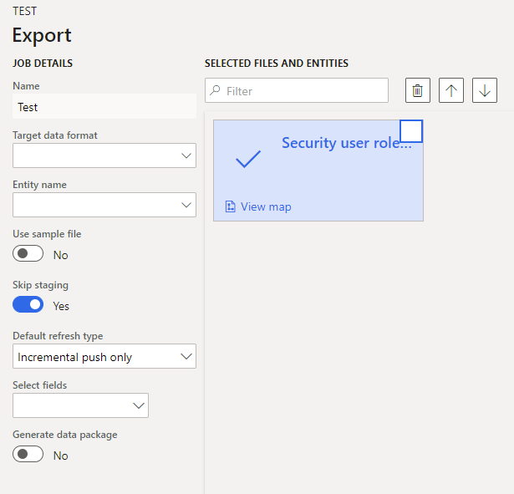
DMF – Data Migration Framework
Interactive in F&O way to import and export data
Works for small or large files
Works with multiple formats
CSV, Excel, XML
No JSON, Parquet, other big data formats
Can be incremental for data import or export
Use artifacts all data entities
Data entities are a collection of tables that represent a concept in business
Customers
Vendors
Sales Order Header

Slide 10
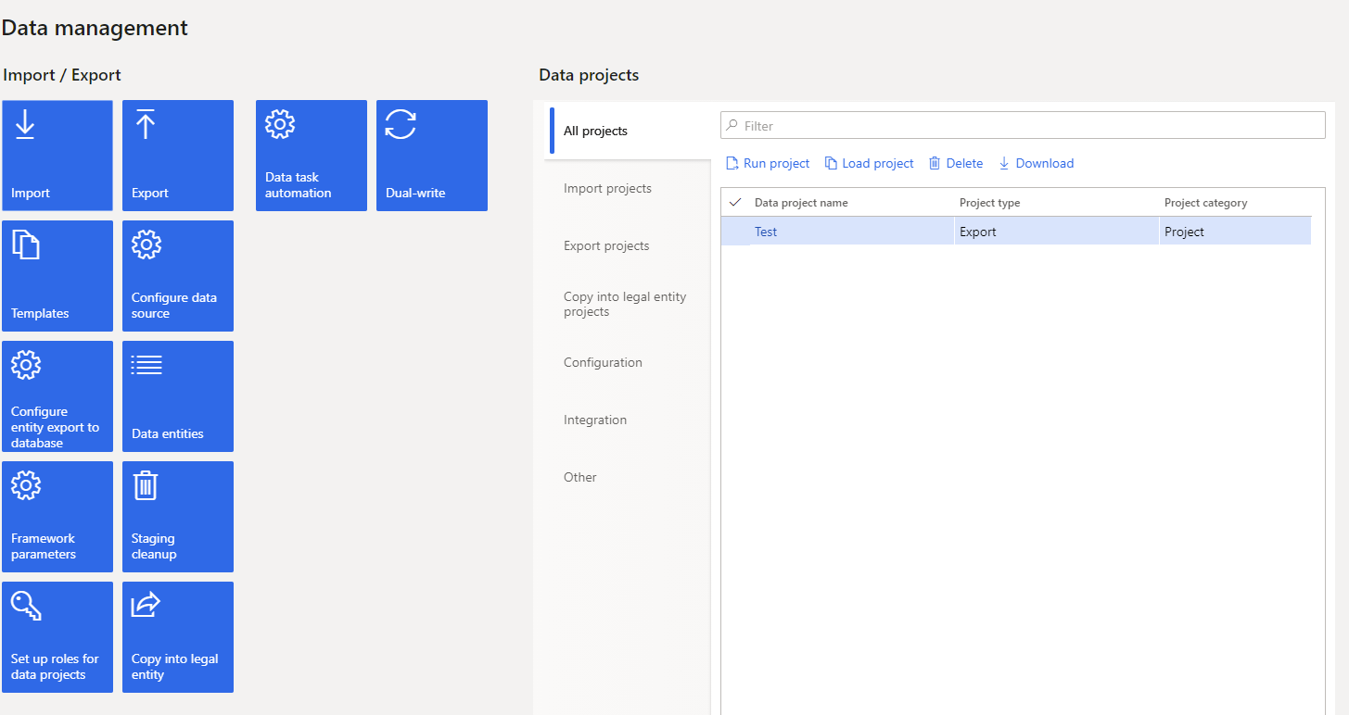
DMF – Data Migration Framework
Dedicated workspace in System Administration
Create data projects for scenario you are working through
UI can be a bit clunky
Collections of data entities called Data Packages

Slide 11
DMF Shootout
The Good
The Bad
Suitable for large data integrations
Incremental data import/export possibility
Staging tables for data validation
Can be used in lots of interactive different scenarios
No support for modern big data formats
UI is not user friendly and confusing
Table lock problems, parallel executions will fail for the same data entity although async import like this is possible
Performance is disappointing

Slide 12
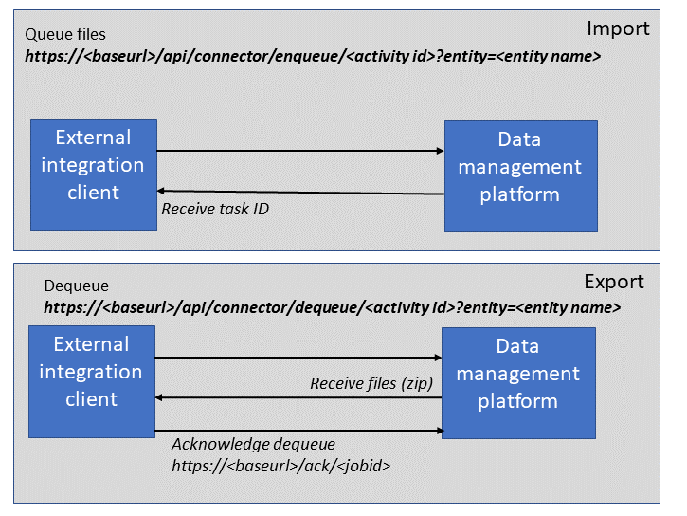
Data Management REST API
DMF but via an API
Programmatic way of interactive with the DMF
Only data packages are supported for import and export
Largely like DMF otherwise

Slide 13
Data Management REST API Shootout
The Good
The Bad
Same as DMF
Can be used to get large quantities of data in and out without relying on a UI
Same as DMF
Table lock problems
Parallel executions will fail for the same data entity although async import is possible

Slide 14
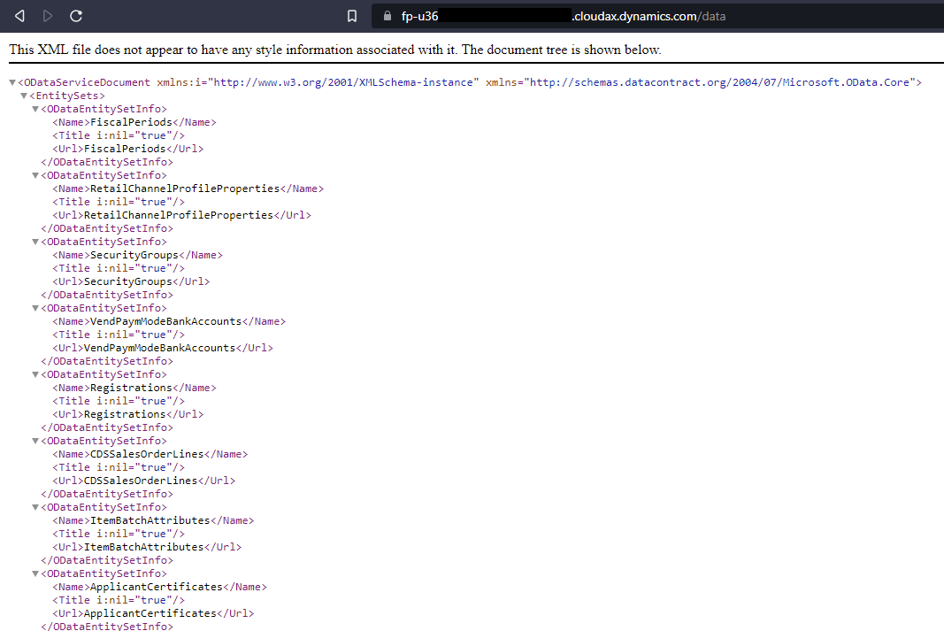
OData
Data entities from the DMF can be exposed to a REST endpoint with AAD OAuth.
Entities in the AOT that are set to public are also OData entities.
Quick, easy, sometimes codeless integration
Support for basic CRUD operations for thousands of entities OOTB

Slide 15
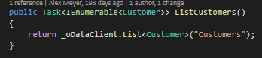
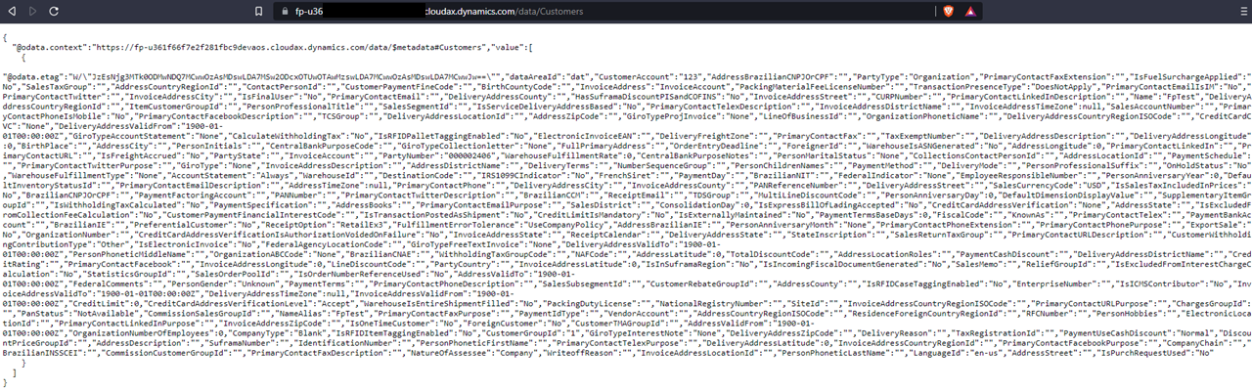
OData
Can use OData actions; basically, methods to execute some logic
Can be used for more complex integration scenarios
Data entities can be complex and support multiple scenarios
Can be throttled

Slide 16
OData Shootout
The Good
The Bad
Easy to use / consume
Lots of OOTB Data entities that support CRUD operations
Plugs into other platforms easily
Custom Actions / methods
Slow queries sometimes
Slow CRUD operations sometimes
Postings generally not supported
Throttling can occur

Slide 17
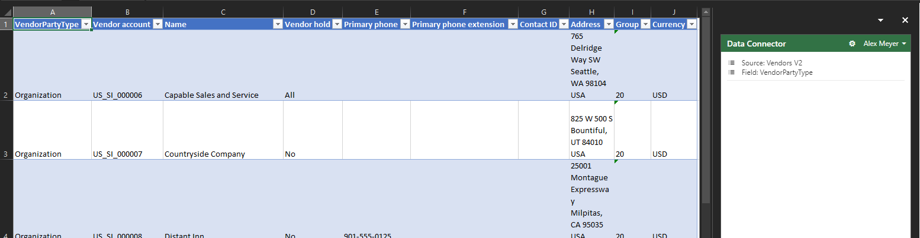
Excel Add-In
It’s Excel
Very similar to OData because it is OData.
Could be a replacement for other upload tools that are Excel based
Export list pages out of F&O, make changes, upload the changes

Slide 18
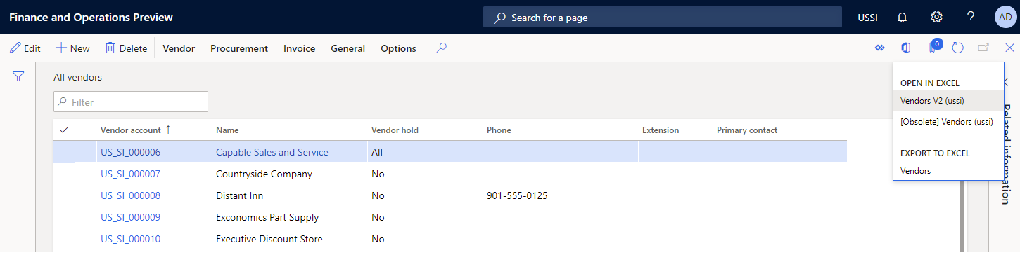
Excel Add-In
Not subject to throttling or resource management
Not all entities work well with Excel
“List Management”

Slide 19
Excel Add-In Shoot Out
The Good
The Bad
Easy to Use
No additional setup – just enable the add on in Excel when prompted
Can be used by anyone that knows Excel
Slow
Sometimes quirky

Slide 20
Custom Services
Powerful and flexible
Support CRUD operations as well as posting of transactions
X++ based, you build to suit
Replacement for AIF services from older versions
SOAP and JSON formats with AAD OAuth

Slide 21
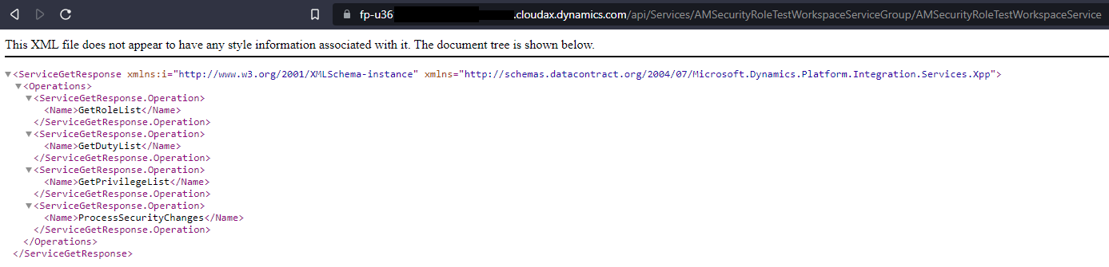
Custom Services
Uses contract which are converted to JSON or XML
No endpoint management tools like in older versions
Could support large data loads*

Slide 22
Custom Services Shoot Out
The Good
The Bad
Flexible and customizable
High performance*
Support CRUD and postings
JSON and SOAP endpoints automagically
Could use Azure API Manager
May not work with large* data transfers
X++ based
Requires experienced developer
No management or monitoring in F&O
May have to use Azure API Manager

Slide 23
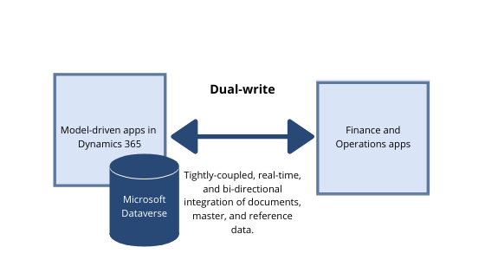
Dual Write
“Couple” data in F&O to Dataverse (formerly CDS)
Push/pull data from Dataverse to F&O
Near real time, “tightly coupled” data entities
Currently Async but someday will be sync
Can be running or paused

Slide 24
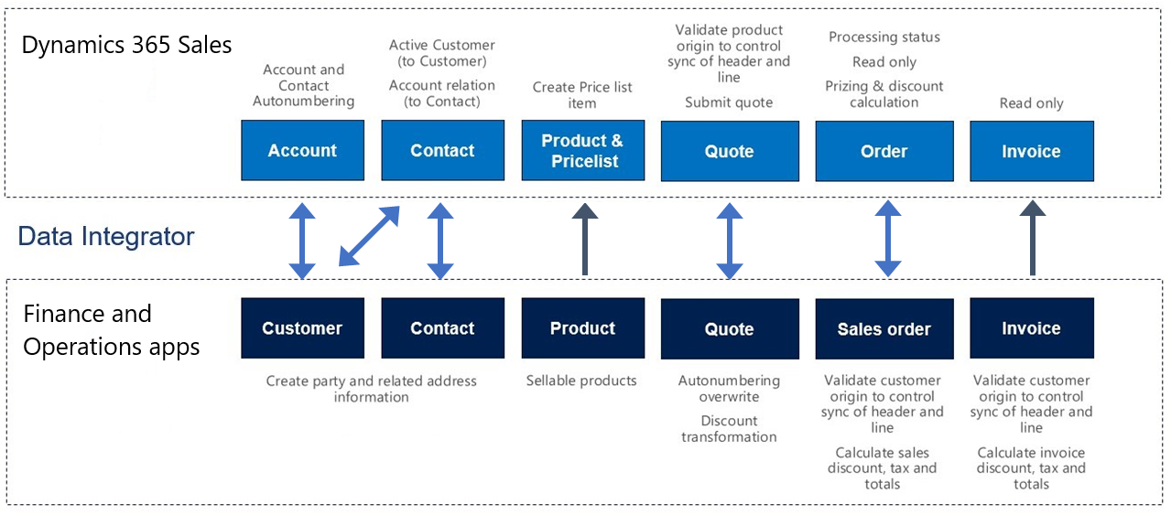
Dual Write
Near Real-Time
Setup in F&O, do an initial sync then start real-time sync mode
Not all data entities are available
Some data in different structures between D365 apps

Slide 25
Dual Write Shoot Out
The Good
The Bad
Near real-time integration with Power Platform / Dataverse
Paused and running modes with cached writes in paused mode
Queries and filters for data
Can create custom data entities and maps in F&O plus Dataverse
Async, near* real-time*
Not all data models are supported
Still being invested in and changing

Slide 26
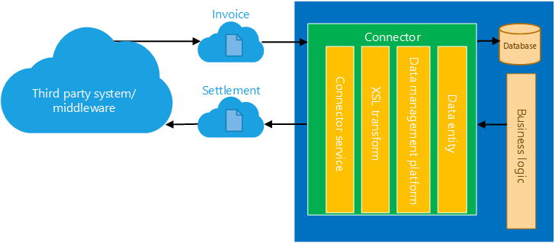
Recurring Integrations
Build on Data Entities and DMF
Enables third party apps to import data into or export data out of F&O
Standard DMF functionality; XSLT, Filters, mapping, formats, etc.

Slide 27
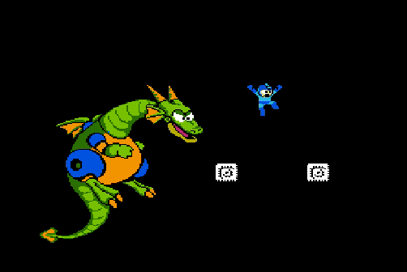
Recurring Integrations
DMF on a schedule
Create Data Project
Schedule Recurrence
Exchange files
Send import and monitor
Request export, monitor, get file
AAD OAuth

Slide 28
Recurring Integrations Shootout
The Good
The Bad
Feature complete integrations
Unlike Batch Data API, this supports import and export
Automated and scheduled
APIs are MSFT and not extensible
Offered “as-is” with no customization

Slide 29
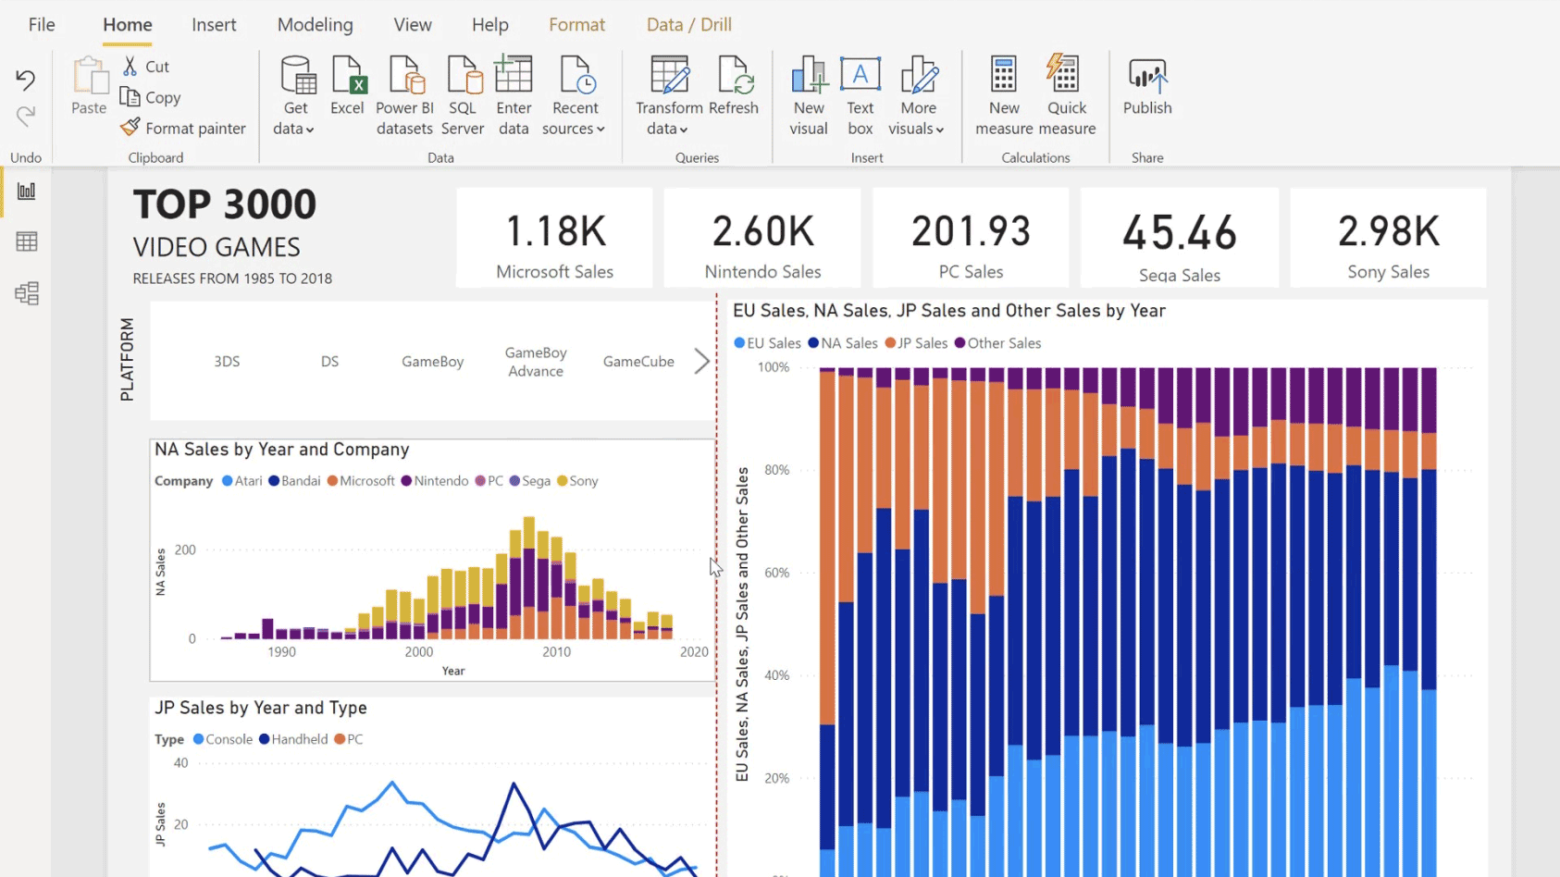
Power BI
PowerBI.com integration comes with F&O
Power BI desktop may be additional (depends on licensing)

Slide 30
Power BI Shootout
The Good
The Bad
If customization required, can be connected to Data Entity or Service Operation endpoint
As Is or Build your own

Slide 31
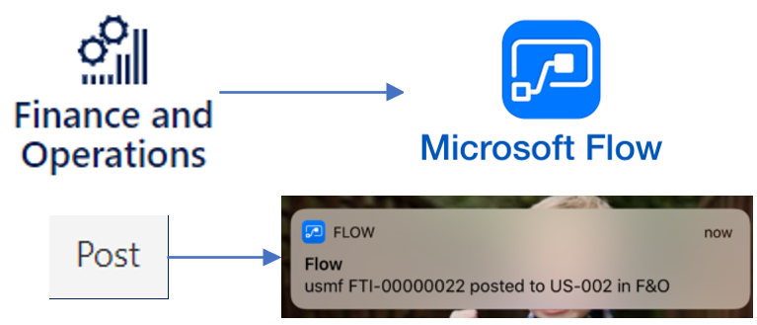
Business Events
Send out that something happened
Catalog of available events but you can build your own also
Lots of different endpoints available in Azure and HTTPS recipients
Lightweight messaging framework

Slide 32
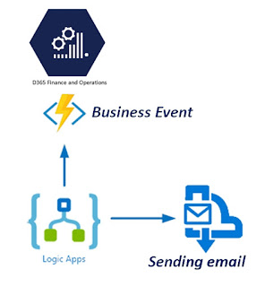
Business Events
Can be used to send a simple notification, start or update a workflow in Power Automate, send a message to a queue or event grid in Azure
Simple, Lightweight
(near) Real-time emission of events
Suggest using batch job

Slide 33
Business Events Shoot Out
The Good
The Bad
(near) real time emission of events from F&O for outside actors to respond to
Subscription to events automagical with Power Automate or Logic Apps
Create custom events if what you want isn’t already in calendar
Messages should be tiny, only contain what you need
Not a data transmission framework
Custom events required X++ development

Slide 34
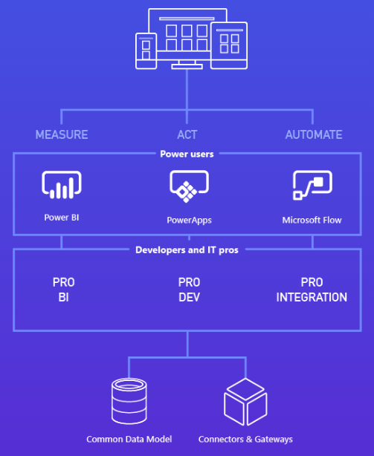
Power Platform
Using Dual-Write, you can use tools from Power Platform
Power BI and Power Automate already have specific integrations
Can use Power Apps and Virtual Agents with F&O data
Simple, departmental UIs

Slide 35
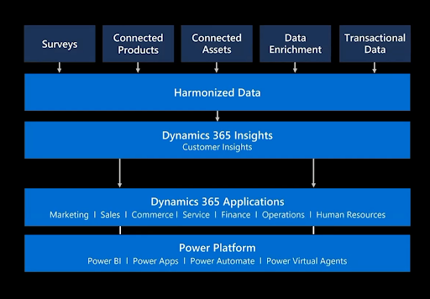
Power Platform
Solve specific business problems or scenarios using custom “low-code” Apps
Could use Virtual Agents aka “Chatbots”
Simple, fast interactions like “where’s my order” or “I’d like to return my order”

Slide 36
Power Platform Shoot Out
The Good
The Bad
Enables solving department opportunities one small problem at a time
Powerful
Complements F&O, doesn’t replace it
Advanced scenario requiring Dual-Write or Azure Data Lake
Use Appropriate Tooling

Slide 37
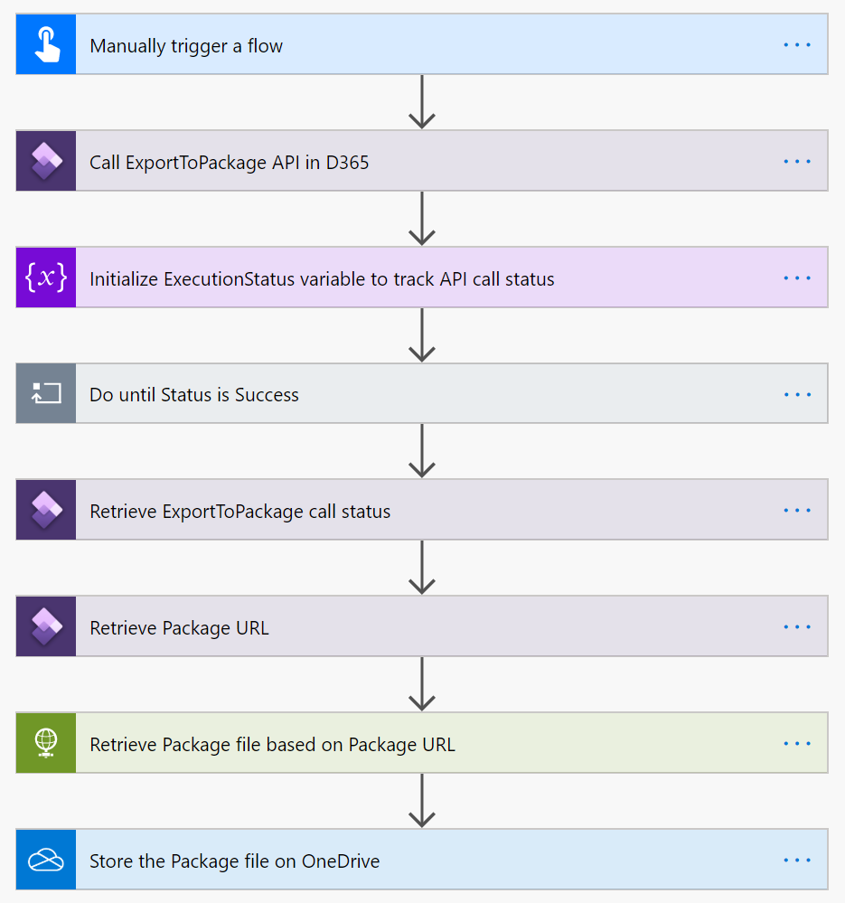
Power Automate
Can just point Power Automate at an F&O instance to get available options
If trigger is deleted or workflow is turn off, Business Event is deleted
Multiple Workflows can subscribe to different events

Slide 38
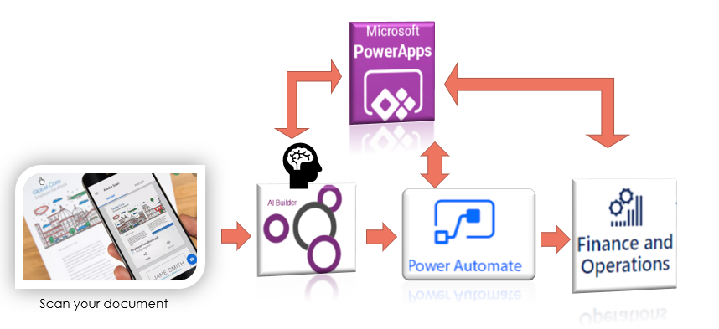
Power Automate
Works with Business Events as well as Azure Event Grid (using a connector)
All available in Power Automote
Nothing specific to F&O except knowing what environment to connect to

Slide 39
Power Automate Shoot Out
The Good
The Bad
Simple
Powerful
Supports several scenarios
All work performed in Power Automate
Limited by F&O Business Event Catalog
May require F&O Development to support Power Automate scenario

Slide 40
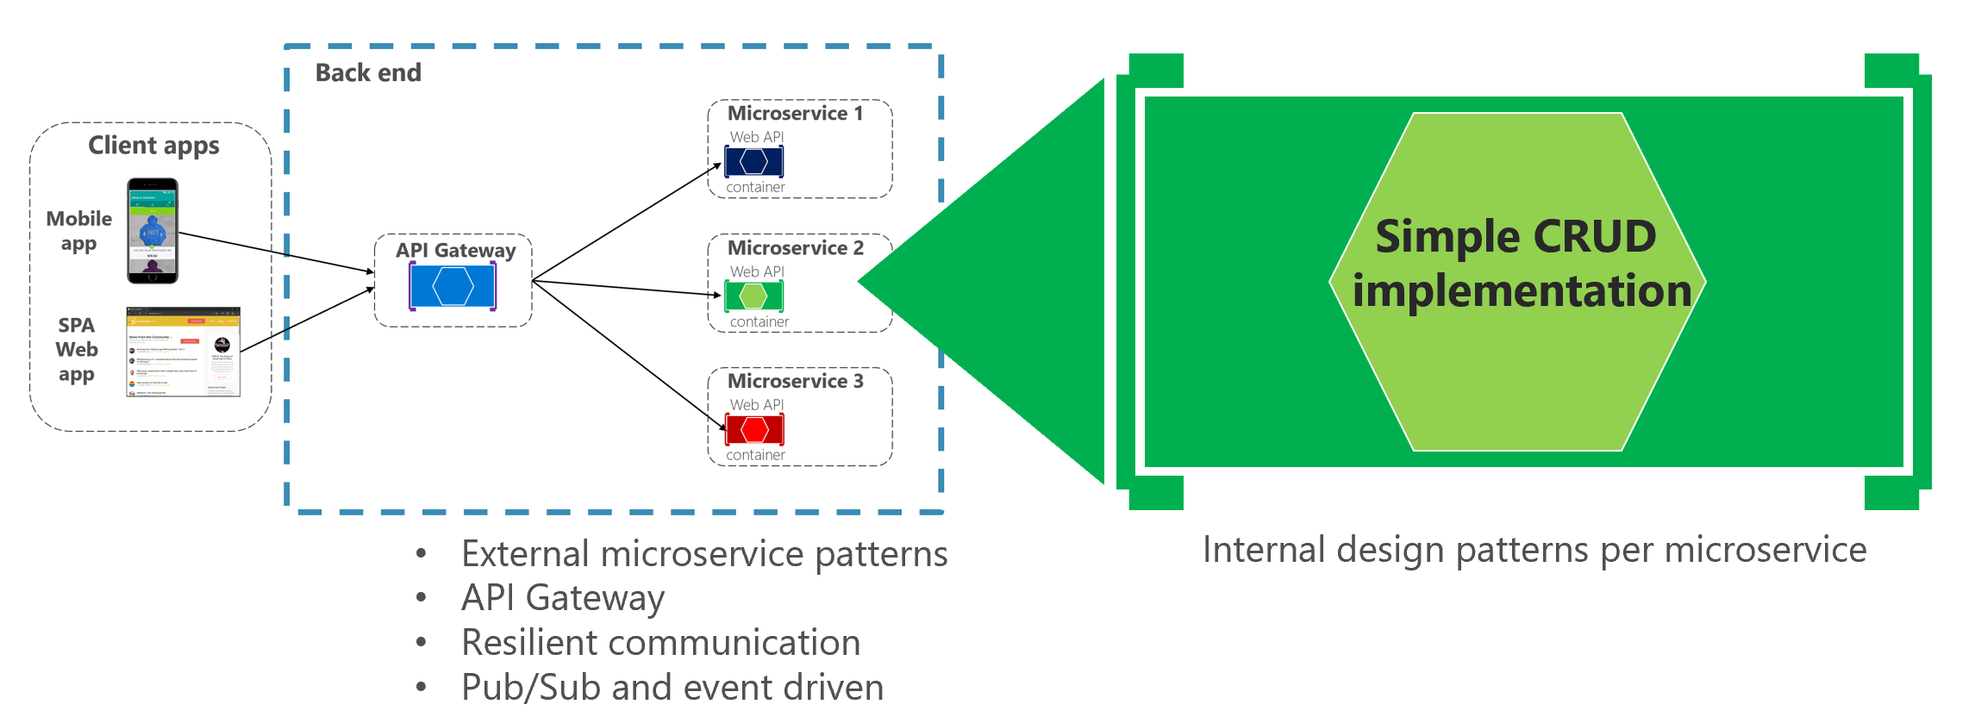
External Services (3rd Party outside F&O)
Consume outside APIs using X++ and .NET
Add .NET for specific API (wrapper, library, etc.)
Async and sync APIs are support with different design patterns
Similar to AIF related options in 2012 but with .NET

Slide 41
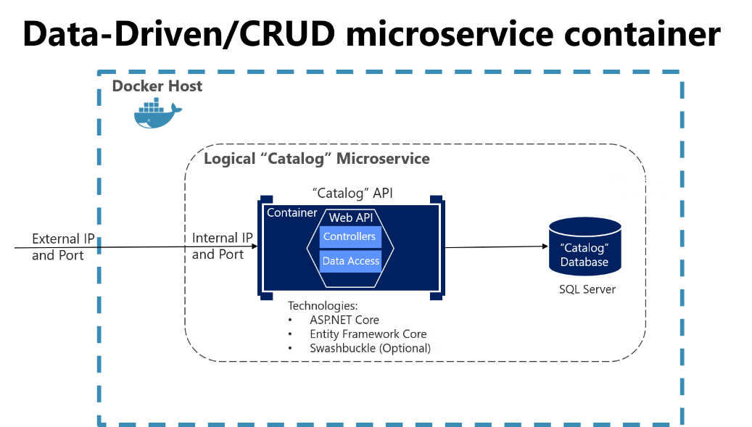
External Services (3rd Party outside F&O)
Create .NET project
Create x++ project
Call .NET binary in x++
Process the (final) result

Slide 42
External Services Shoot Out
The Good
The Bad
Generally high performance
Interacting directly with outside data source with no middleware
Flexible; build what you need how you need it
X++ development plus .NET development
Interacting directly with outside data source with no middleware

Slide 43
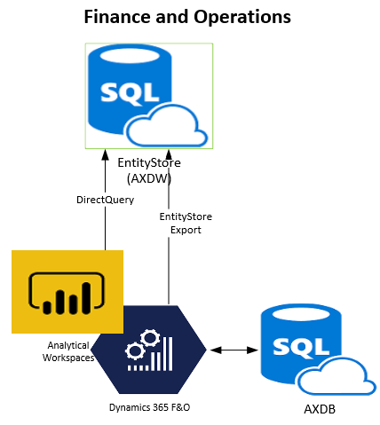
Entity Store
Database optimized for reporting that is included with F&O
Uses in-memory, clustered columstore index (CCI) on SQL Server
Star-Schema based using data entities to provide aggregate measures

Slide 44
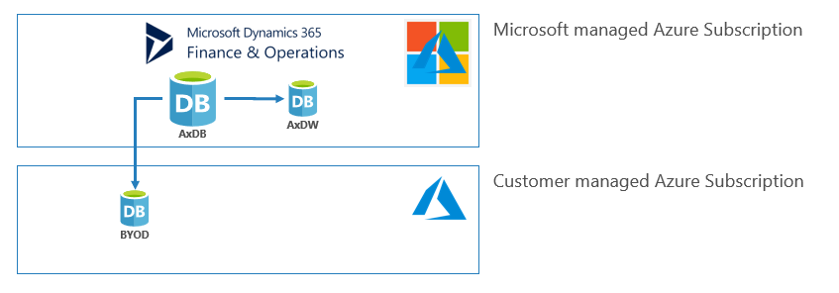
Entity Store
Can connect via PowerBI using DirectQuery
Can create reports for large data sets based on measure and reports are updated when the entity store is updated
Schedule refreshed, typically nightly
Build your own measures

Slide 45
Entity Store Shoot Out
The Good
The Bad
Fast way of providing analytical data
Batch/schedule processing
Read Only
Power BI Only

Slide 46
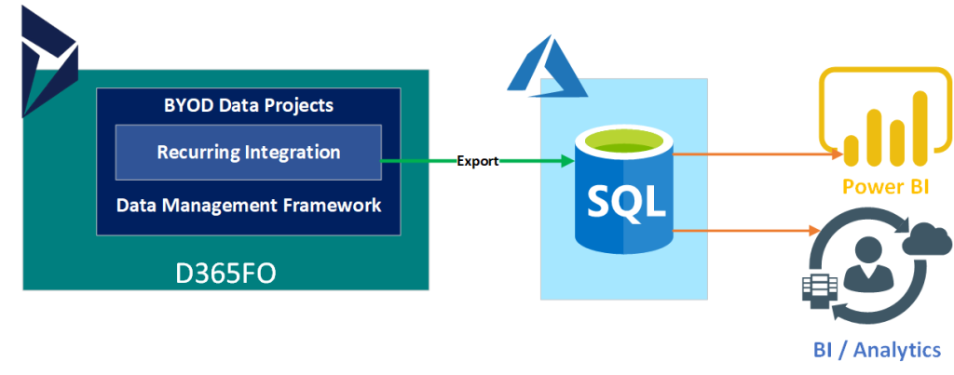
Bring Your Own Database (BYOD)
Export data entities to your own Azure SQL Instance (that you pay for)
Different from the Entity Store; BYOD is your, Entity Store is MSFT’s
Full or incremental push
More than one database
Schedule data refreshes

Slide 47
Bring Your Own Database (BYOD)
Access to data through standard SQL Connectors
Use change tracking to updates
Database can be extended to deliver specific data with new tables or views
Could be use for outbound SQL only interfaces

Slide 48
Bring Your Own Database Shoot Out
The Good
The Bad
Export Data Entities to a database you control
Can be accessed how you define it
Filtering is possible
Full or incremental pushes
Refreshes are scheduled
One way; export only
Sometimes slow
Cost and management

Slide 49
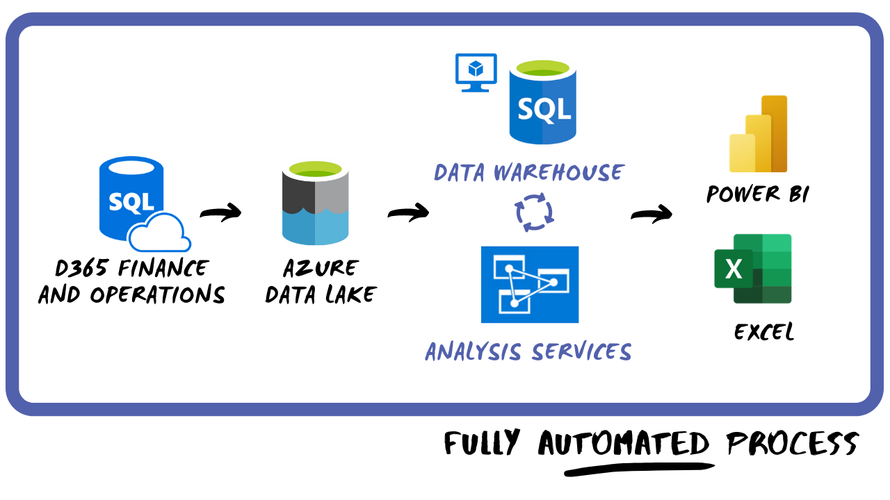
Azure Data Lake
Storage technology for Azure Data Lake Storage Gen2
Lower cost cloud storage compared to DBs
Included in customer subscription so you can bring your open data and integrate it
Allows users to build reports with their tool of choice

Slide 50
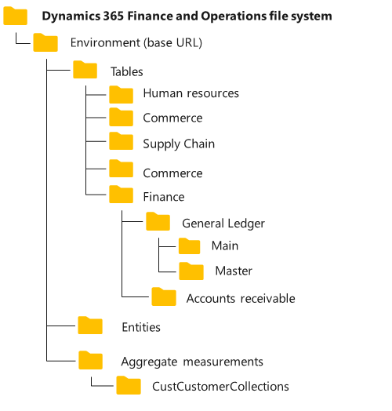
Azure Data Lake
You can select tables to be kept in sync between F&O and Data Lake (<10 minutes)
Data are stored in Common Data Model folder standard
CDM Standard means other tools can also read the data
Use data pipelines for further processing

Slide 51
Azure Data Lake Shoot Out
The Good
The Bad
Reduced storage cost compared to alternatives
Near real-time integration with automagic feeds
CDM storage standard
Can use other tools for reporting or processing of data
One way only
Advanced Scenarios require specialized skill sets

Slide 52
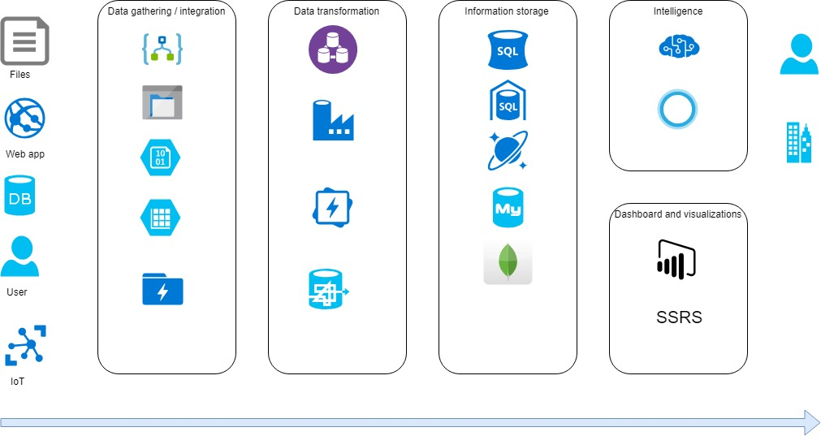
Azure Toolset
LogicApps or Functions Apps for Business Events
Azure Data Factor for Azure Data Lake
API management for OData
AI Builder plus OData
Service Bus for Business Events or messaging in general

Slide 53
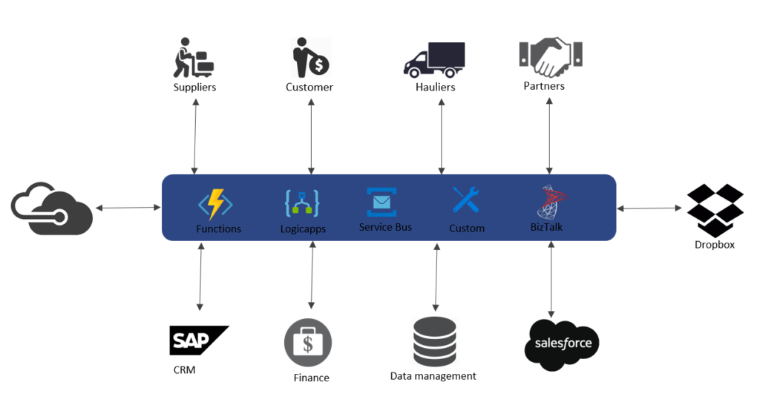
Azure Toolset
Event Grid for Business Events
Azure Functions / Function Apps for literally everything else
Log Analytics from LCS*

Slide 54
Azure Toolset Shoot Out
The Good
The Bad
Tools available for most scenarios
Simple and Powerful
Additional specialized skillsets
Costs

Slide 55
Questions?

Slide 56
Dynamics 365: Let’s talk Upgrade Rollout Approach (AX 2012 Upgrade Series: Part 6) – Tuesday @ 2:00
Dynamics 365 F&O Licensing, Upgrades, Costs and More (Part 2) – Tuesday @ 3:00
Retail and Warehousing: The Biggest Areas for Change in Dynamics 365 F&O (AX 2012 Upgrade Series: Part 3) – Wednesday @ 9:30
AX Sucks. Let’s talk Upgrades (AX 2012 Upgrade Series: Part 1)– Wednesday @ 10:30
An AX2012 Upgrade Journey - Wednesday @ 11:30
Dynamics 365 F&O Business Events From End to Start to End – Wednesday @ 1:40
Dynamics 365 F&O Upgrade Tech Talk: Code, Customizations, Extension and Power Platform (AX 2012 Upgrade Series: Part 5) – Thursday @ 10:00
How To Get The Most Out of Your Upgrade (AX 2012 Upgrade Series: Part 2) – Thursday @ 1:10

Slide 57
My Other Presentations
Dynamics 365 F&O Business Events From End to Start to End – Wednesday @ 1:40
Dynamics 365 F&O OData From Zero To Hero – Thursday @ 9:00
F&O Integration Roundup - Thursday @ 11:00
X++ Development Tips and Tricks plus D365FO.Tools! – Thursday @ 2:10

Slide 58
Give Away!

Slide 59

Please visit our booth
enVista booth #700
Meet with our experts
Learn about industry-leading practices
Get the most from your Microsoft investments
Register to win a YETI™ cooler
enVista
Booth
Hall C Entry

Slide 60

Visit the Fastpath Booth
Security, Audit, Compliance, User Licensing
Supports all Dynamics products
Booth #1721

Slide 61

Survey Code

